Slide 1
Math Analysis
Patrik Oliveira Dos Santos

Slide 2
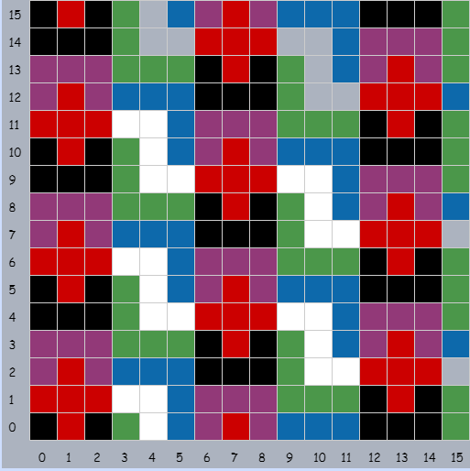
01_Pattern
On the Grid

Slide 3
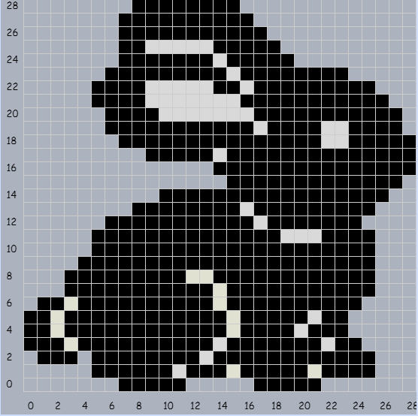
02_Pixel Art
On the Grid

Slide 4
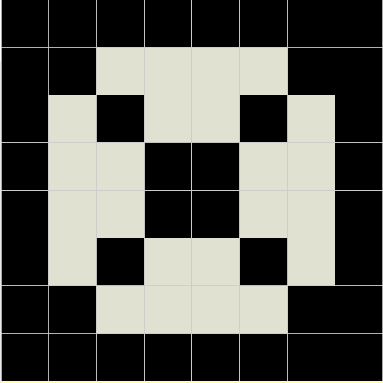
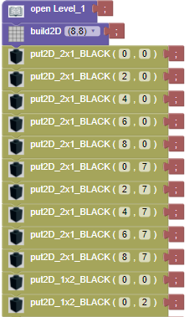
03_Saving in Bricklayer-lite Level 1

Slide 5
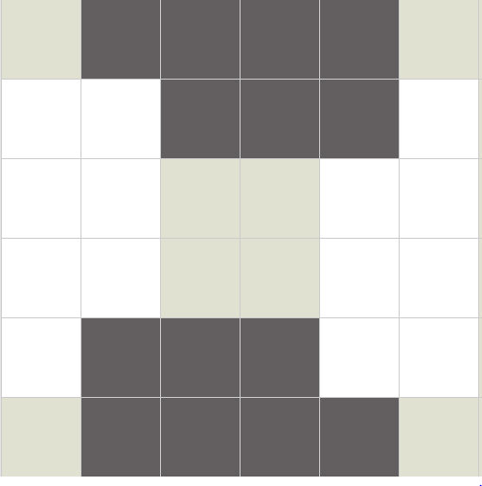
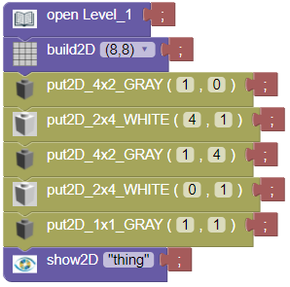
04_Objects in Bricklayer-lite Level 1

Slide 6
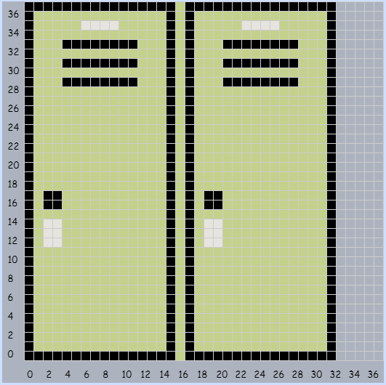
05_Objects around Bryan
On the Grid

Slide 7

06_Name Project
Level 2

Slide 8
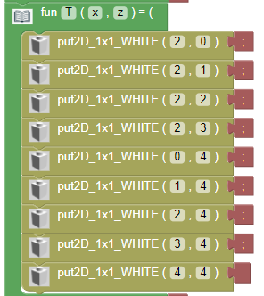
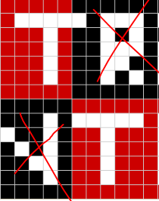
Function for the "T"

Slide 9
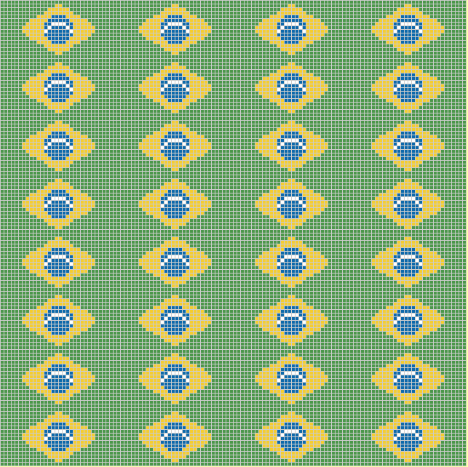
07_Flag Project
Level 3

Slide 10
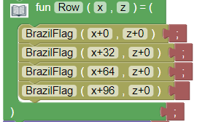

Function for a row, that was used to fill in the entire grid, on the previous slide.

Slide 11
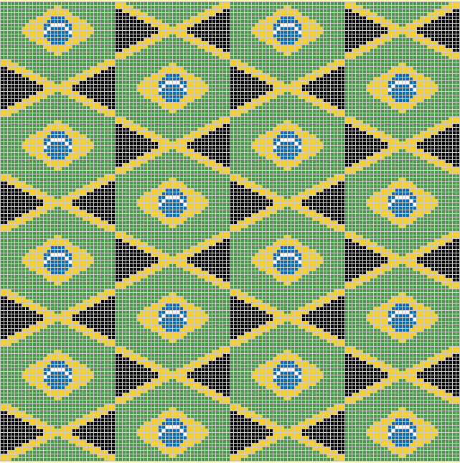
Flag Challenge

Slide 12
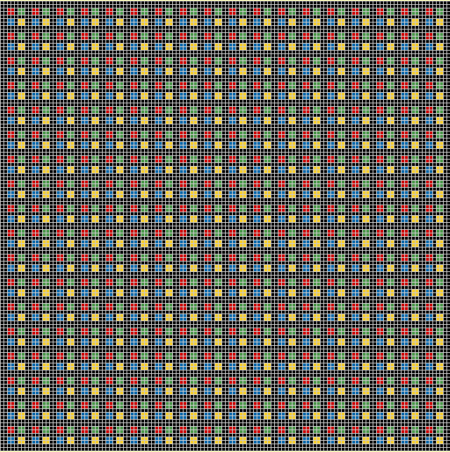
08_More Patterns
Level 3

Slide 13
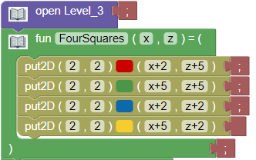

Function Used to group 4 squares together

Slide 14
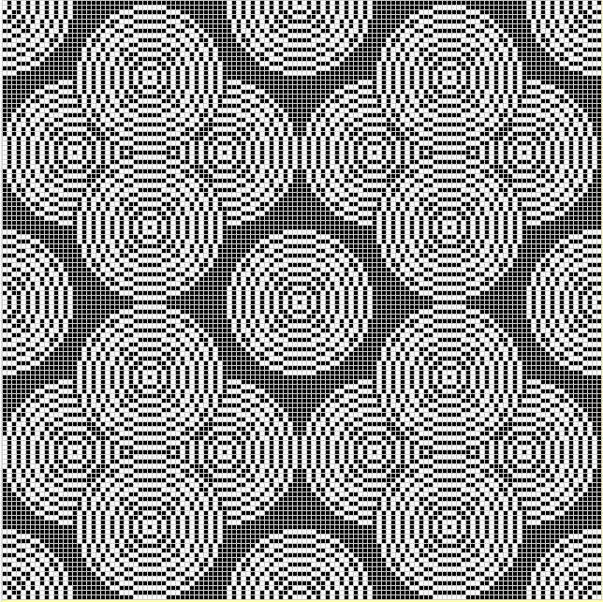
10_Ring Circle
Pattern
Level3

Slide 15
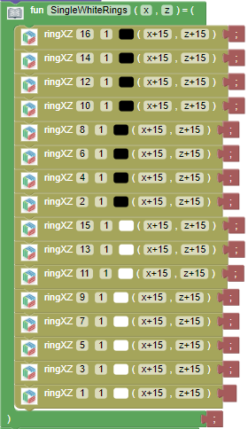
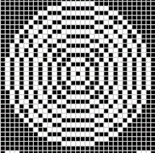
Function for a Circle

Slide 16
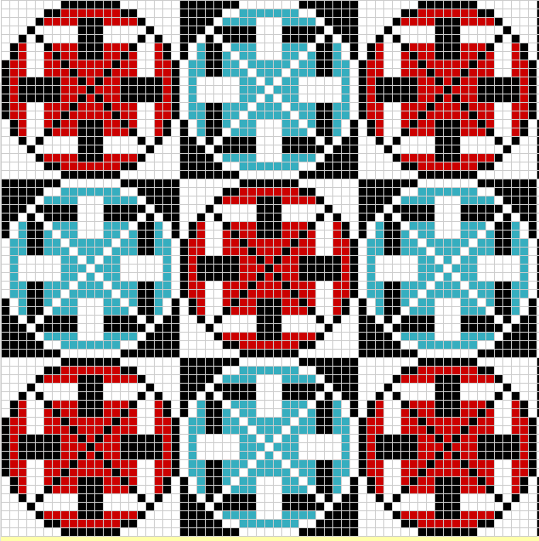
11_All Functions
Level 3

Slide 17
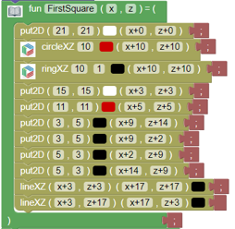

Function for one of the "squares"

Slide 18
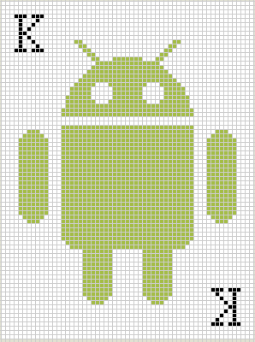
12_Real Image
Level 3

Slide 19

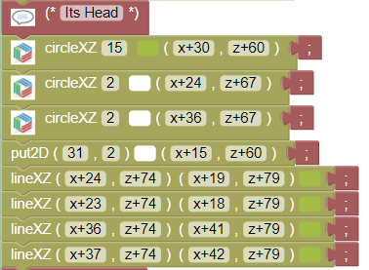

Slide 20
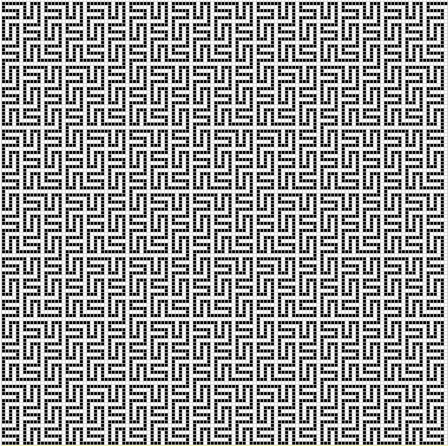
13_Space Filling Curves
Level 3

Slide 21
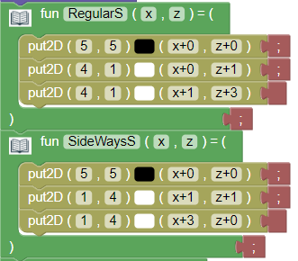
Function for the basic shapes for the pattern.

Slide 22
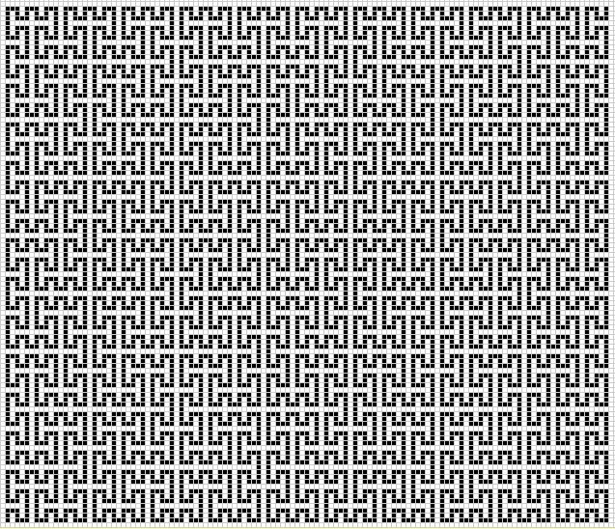
Challenge Space filling curves

